Slide 1
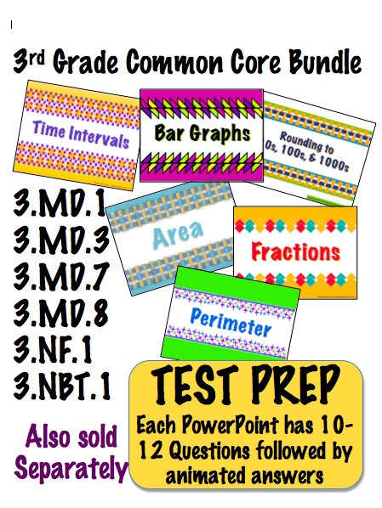
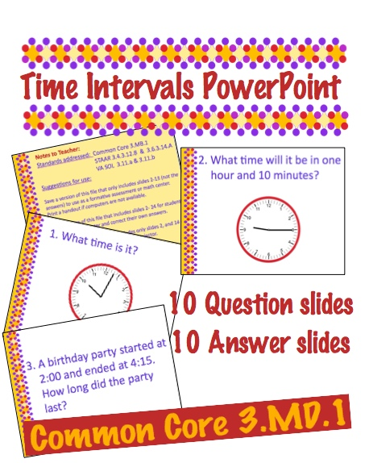
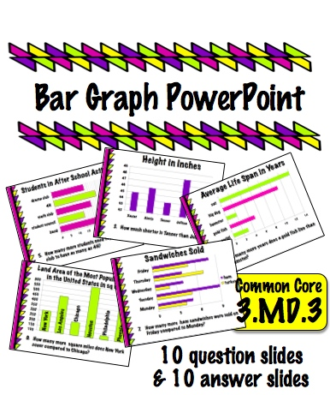
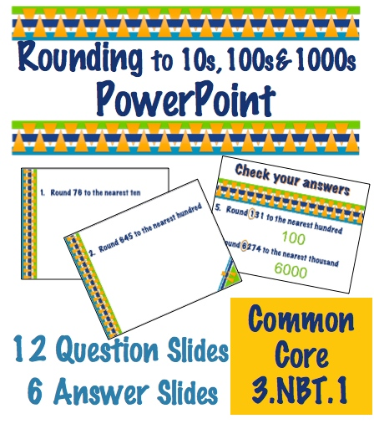

Slide 2
Notes to Teacher:
Standard addressed: Common Core 3.MD.8
Solve real world and mathematical problems involving perimeters of polygons, including finding the perimeter given the side lengths, finding an unknown side length, and exhibiting rectangles with the same perimeter and different areas or with the same area and different perimeters.
Suggestions for use:
Save a version of this file that only includes slides 3-13 (not the answers) to use as a formative assessment or math center.
Print a handout of slides if computers are not available.
Save a version of this file that includes slides 3- 25 for students to work on a computer and correct their own answers.
Save a version of this file that includes only slides 3, and 15 – 25 to use for full class practice using a projector.

Slide 3
©2012,LisaTarman-TeachersPayTeachers.com

Slide 7
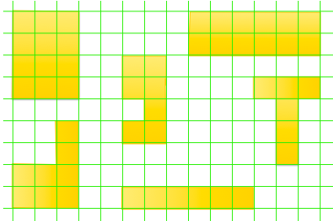

Slide 8
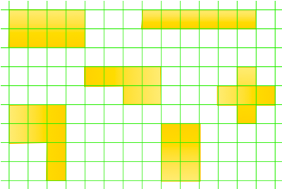

Slide 9
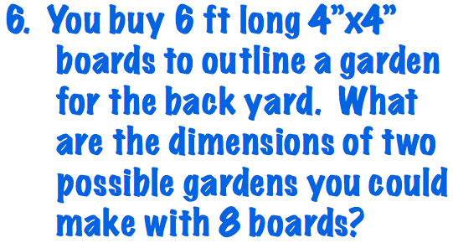
6 ft

Slide 10
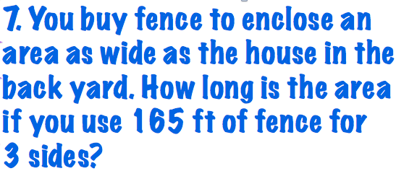
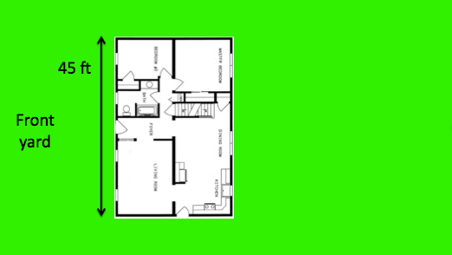

Slide 11
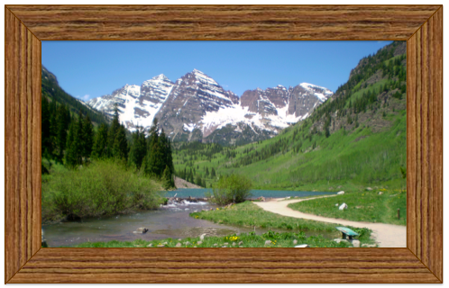
18 in

Slide 12
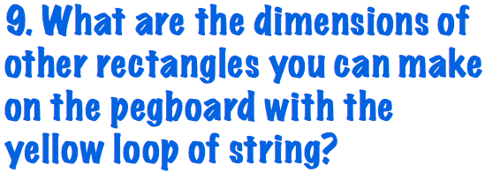

Slide 13
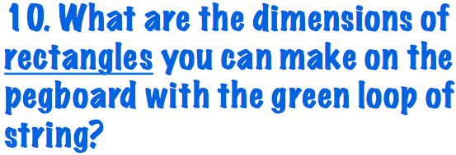

Slide 14
©2012,LisaTarman-TeachersPayTeachers.com

Slide 18
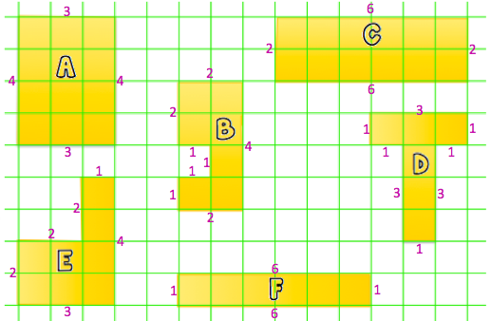

Slide 19
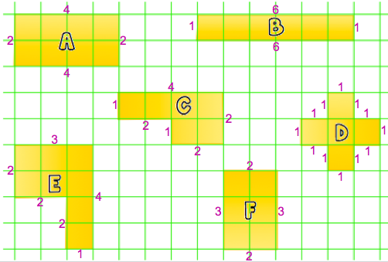

Slide 21
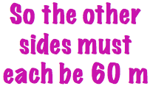

Slide 22
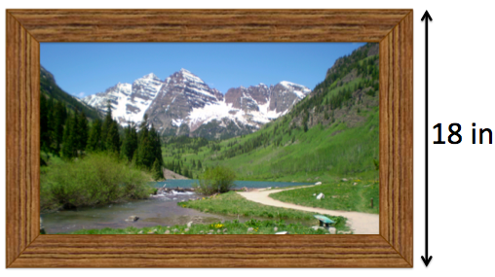

Slide 23
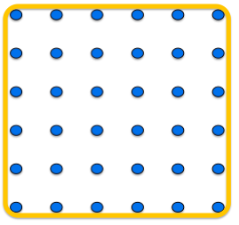
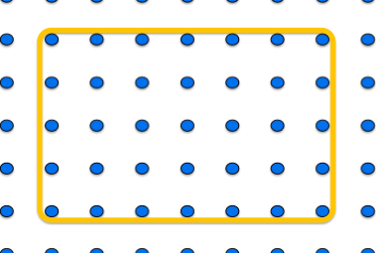
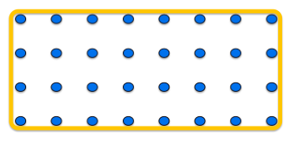

Slide 24
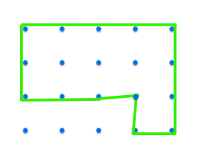
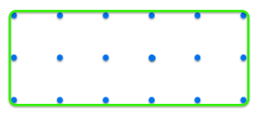
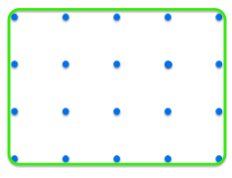

Slide 25
©2012,LisaTarman-TeachersPayTeachers.com

Slide 26
http://teacherspayteachers.com/Store/Lisa-Tarman
Click here to sign up to
sell your things on
Teachers Pay Teachers

Slide 27
